Slide 1

Cover page
TIC TAC TOE
GAME
G.Nagasaikarthik
12110784
Atiketi.Harshith
12109254
Anugula.Rahul
12109266

Slide 2
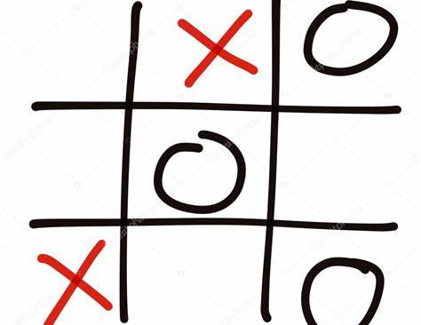
KIDS PROFESSIONAL COLORING BOOK – PICTURE 1
History: Game played on three-in-a-row boards can be traced back to ancient Egypt, where such game boards have been found on roofing tiles dating from around 1300 BC. An early variation of tic-tac-toe was played in the Roman Empire, around the first century BC.

Slide 3

Abstract: Tic-tac-toe is a classic two-player game played on a 3x3 grid. Each player takes turns marking a square with their symbol (usually X or O) until one player gets three in a row, either horizontally, vertically, or diagonally. The game is simple to learn, but can be challenging to master, as players must anticipate their opponent's moves and plan their own strategy accordingly. In this abstract, we explore the rules and strategies of tic-tac-toe, and discuss various approaches to playing the game, including optimal play and heuristic-based strategies. We also examine variations of the game, such as larger boards and different win conditions, and consider how these changes affect gameplay. Tic-tac-toe is a timeless game that continues to be enjoyed by players of all ages and skill levels, and serves as an important example of simple but engaging game design.

Slide 4

This Java program is a simple implementation of the classic game Tic Tac Toe, also known as Noughts and Crosses.
The program uses the Java Swing library to create a graphical user interface. It creates a main JFrame window with a 3x3 grid of buttons that represent the Tic Tac Toe game board. Each button is a JButton object that can be clicked to make a move. The program keeps track of whose turn it is using a boolean variable called xTurn.

Slide 5
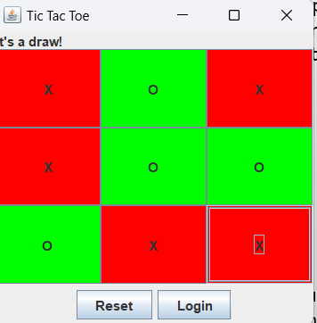
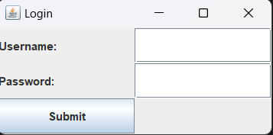
When a button is clicked, the program checks if the button is empty. If it is, the program sets the text of the button to either "X" or "O" depending on whose turn it is, and changes the background color of the button accordingly. The program then checks if the move resulted in a win or a draw. If it did, the program displays a message and disables all the buttons. Otherwise, the program switches the turn to the other player.
The program also includes a login feature, which is implemented using a separate JFrame window. When the program starts, it displays the login window first. The user is prompted to enter a username and password. If the user enters "admin" as the username and "password" as the password, the program hides the login window and displays the Tic Tac Toe window. If the user enters incorrect credentials, the program displays an error message using a JOptionPane dialog.
The program includes a "Reset" button and a "Login" button at the bottom of the Tic Tac Toe window. The Reset button resets the game board and the turn to their initial states. The Login button hides the Tic Tac Toe window and displays the login window.

Slide 6
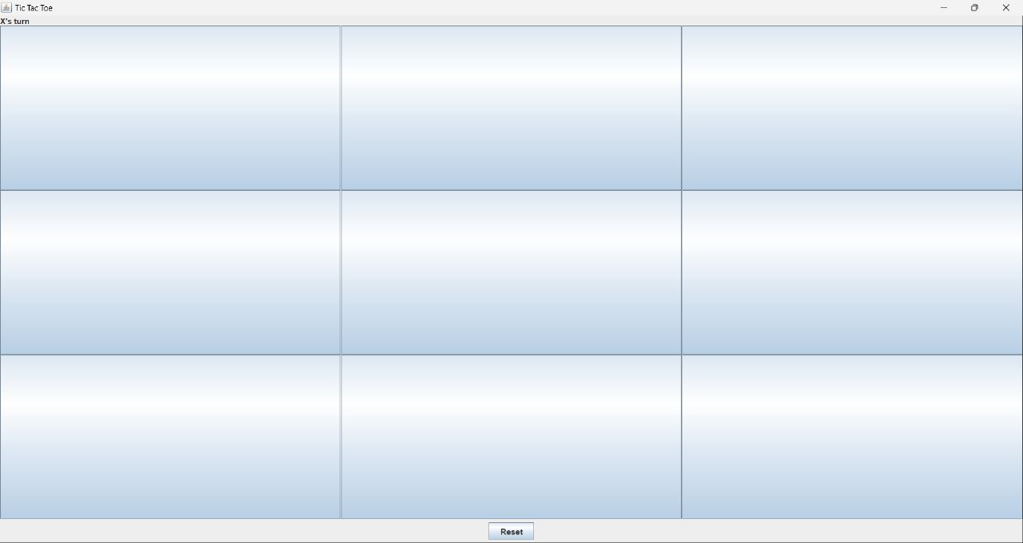
Game GUI

Slide 7
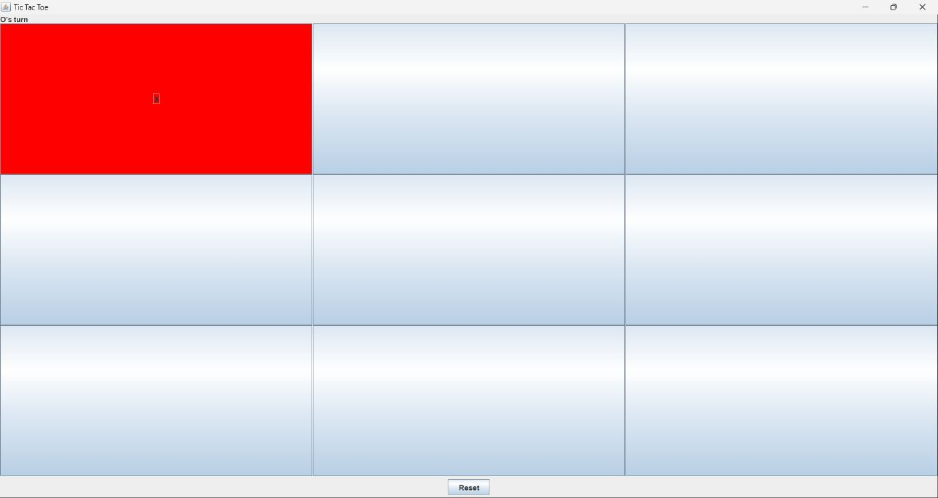
Its O’s- turn

Slide 8
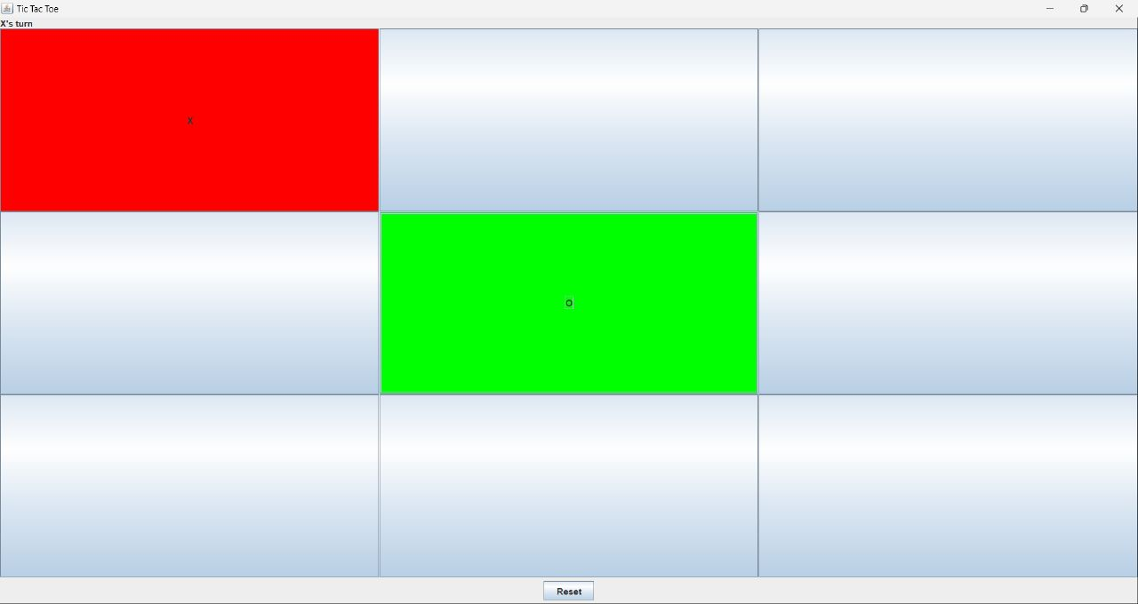
Now Its X’s- turn

Slide 9
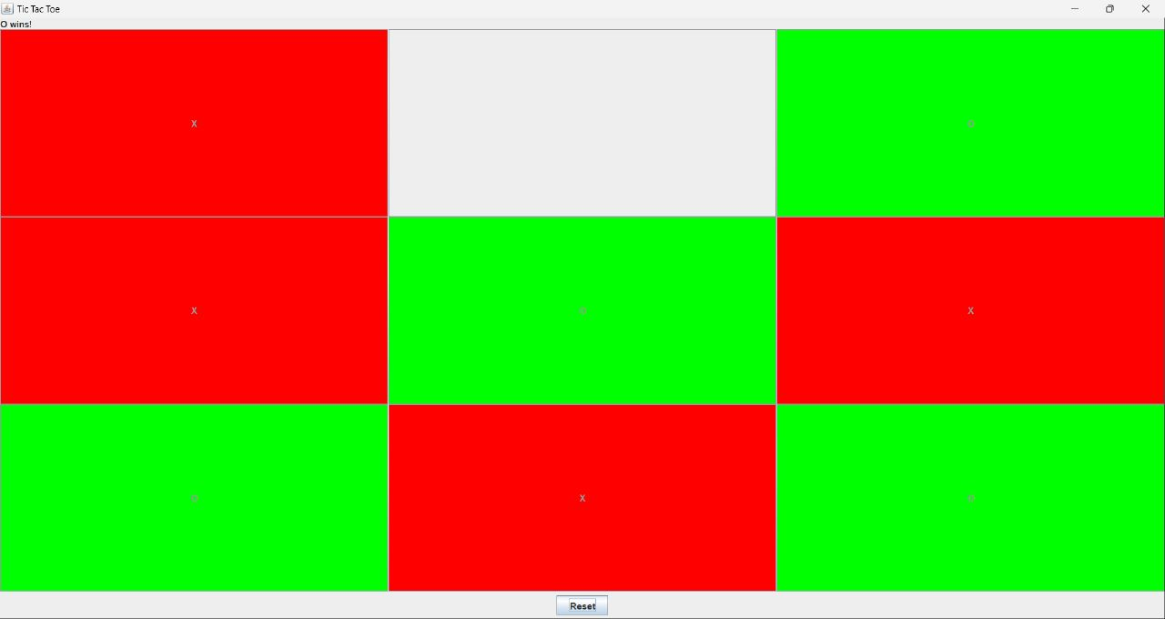
Result of the Game

Slide 10

Future Scope
AI opponent: One of the most interesting enhancements would be to create an AI opponent for the game. This would require developing a machine learning model that can learn to play Tic Tac Toe and make strategic moves against the human player. This could make the game more challenging and engaging.

Slide 11
Multiplayer functionality: Another enhancement would be to add multiplayer functionality, so that two people can play against each other on different devices. This would require developing a networking system to allow players to connect and communicate with each other in real time.

Slide 12

Thank you

